Slide 1

Part 3
Chapter 13
Eigenvalues
PowerPoints organized by Prof. Steve Chapra, Tufts University
All images copyright © The McGraw-Hill Companies, Inc. Permission required for reproduction or display.

Slide 2
Chapter Objectives
Understanding the mathematical definition of eigenvalues and eigenvectors.
Understanding the physical interpretation of eigenvalues and eigenvectors within the context of engineering systems that vibrate or oscillate.
Knowing how to implement the polynomial method.
Knowing how to implement the power method to evaluate the largest and smallest eigenvalues and their respective eigenvectors.
Knowing how to use and interpret MATLAB’s eig function.

Slide 3
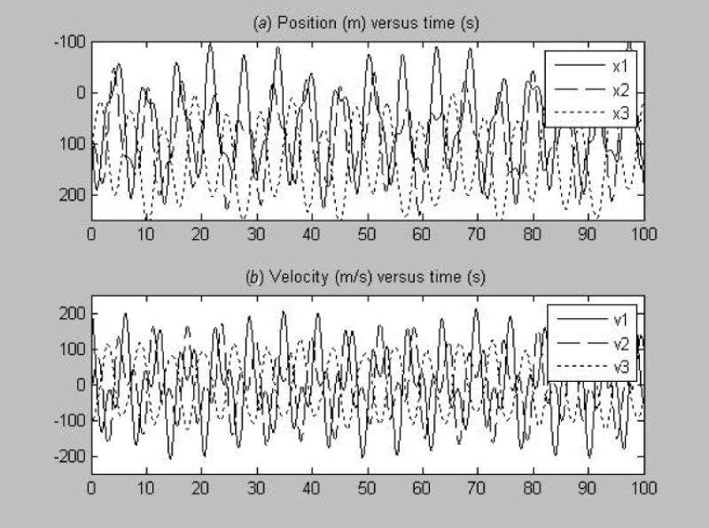
Dynamics of Three Coupled Bungee Jumpers in Time
Is there an underlying pattern???

Slide 4
Mathematics
Up until now, heterogeneous systems:
[A] {x} = {b}
What about homogeneous systems:
[A] {x} = 0
Trivial solution:
{x} = 0
Is there another way of formulating the system
so that the solution would be meaningful???

Slide 5
Mathematics
What about a homogeneous system like:
(a₁₁ – λ) x₁ + a₁₂ x₂ + a₁₃ x₃ = 0
a₂₁ x₁ + (a₂₂ – λ) x₂ + a₂₃ x₃ = 0
a₃₁ x₁ + a₃₂ x₂ + (a₃₃ – λ) x₃ = 0
or in matrix form
[ ]
[A] – λ [Ι ] {x} = 0
For this case, there could be a value of λ that
makes the equations equal zero. This is called
an eigenvalue.

Slide 6
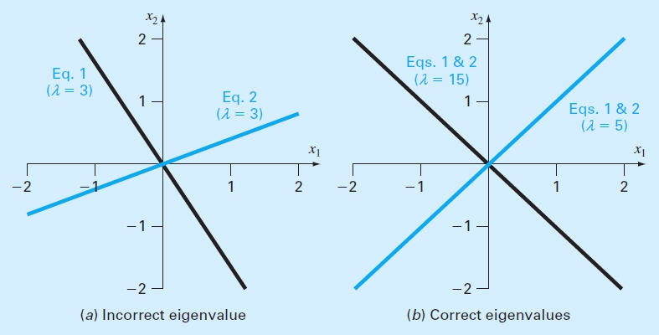
Graphical Depiction of Eigenvalues

Slide 7
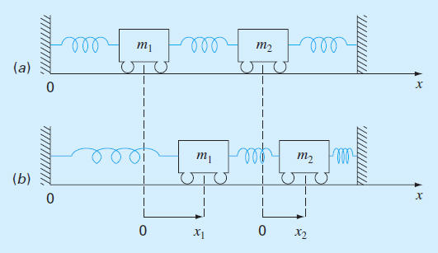
Physical Background:
Oscillations or Vibrations of Mass-Spring Systems

Slide 8
Model With Force Balances
(AKA: F = ma)
d ²x₁
m₁
= – k x₁ + k(x₂ – x₁)
dt ²
d ²x₂
m₂
= – k(x₂ – x₁) – kx₂
dt ²
Collect terms:
d ²x₁
m₁
– k (– 2x₁ + x₂) = 0
dt ²
d ²x₂
m₂
– k (x₁ – 2x₂) = 0
dt ²

Slide 9
Assume a Sinusoidal Solution
2π
x_{i} = X_{i} sin (ω t)
where
ω =
T_{p}
Differentiate twice:
x_{i}” = – X_{i} ω ² sin (ω t)
Substitute back into system and collect terms

Slide 10
2k
k
− ω ² X₁ –
X₂ = 0
m₁
m₁
k
2k
X₁ +
− ω ² X₂ = 0
m₂
m₂
Given: m₁ = m₂ = 40 kg; k = 200 N/m
(10 – ω ²) X₁ – 5 X₂ = 0
– 5 X₁ + (10 – ω ²) X₂ = 0
This is now a homogeneous system where the eigenvalue represents the square of the fundamental frequency.

Slide 11
Solution: The Polynomial Method
10 – ω ² − 5 X₁ 0
– 5 10 – ω ² X₂ 0
=
Evaluate the determinant to yield a polynomial
10 – ω ² − 5
– 5 10 – ω ²
= (ω ²)² − 20ω ² + 75
The two roots of this "characteristic polynomial" are the system's eigenvalues:
15
5
3.873 Hz
2.36 Hz
or
ω =
ω ² =

Slide 12
INTERPRETATION
ω² = 5 /s²
ω = 2.236 /s
T_{p} = 2π/2.236 = 2.81 s
ω² = 15 /s²
ω = 3.873 /s
T_{p} = 2π/3.373 = 1.62 s
(10 – ω²) X₁ – 5 X₂ = 0
– 5 X₁ + (10 – ω²) X₂ = 0
(10 – 5) X₁ – 5 X₂ = 0
– 5 X₁ + (10 – 5) X₂ = 0
(10 – 15) X₁ – 5 X₂ = 0
– 5 X₁ + (10 – 15) X₂ = 0
5 X₁ – 5 X₂ = 0
– 5 X₁ + 5 X₂ = 0
– 5 X₁ – 5 X₂ = 0
– 5 X₁ – 5 X₂ = 0
X₁ = X₂
X₁ = –X₂
–0.7071
–0.7071
–0.7071
0.7071
V =
V =

Slide 13
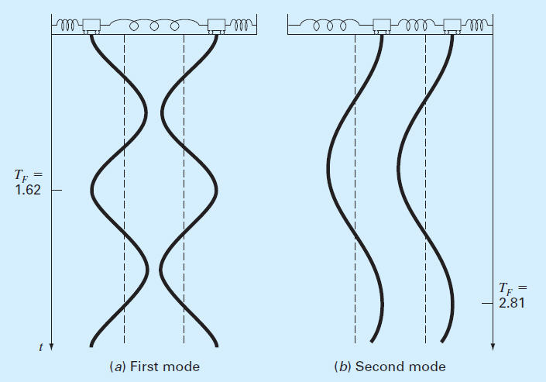
Principle Modes of Vibration
T_{p} = 1.62
T_{p} = 2.81

Slide 14
The Power Method
Iterative method to compute the largest eigenvalue and its associated eigenvector.
[[A] − λ[I]]]{x} = 0
[A]{x} = λ{x}
Simple Algorithm:
function [eval, evect] = powereig(A,es,maxit)
n=length(A);
evect=ones(n,1);eval=1;iter=0;ea=100; %initialize
while(1)
evalold=eval; %save old eigenvalue value
evect=A*evect; %determine eigenvector as [A]*{x)
eval=max(abs(evect)); %determine new eigenvalue
evect=evect./eval; %normalize eigenvector to eigenvalue
iter=iter+1;
if eval~=0, ea = abs((eval-evalold)/eval)*100; end
if ea<=es | iter >= maxit,break,end
end

Slide 15
Example: The Power Method
First iteration:
40 −20 0
−20 40 −20
0 −20 40
1
1
1
20
0
20
1
0
1
=
= 20
Second iteration:
40 −20 0
−20 40 −20
0 −20 40
1
0
1
40
−20
40
1
−1
1
=
= 40
40 − 20
40
|ε_{a}| =
× 100% = 50%

Slide 16
Example: The Power Method
Third iteration:
40 −20 0
−20 40 −20
0 −20 40
1
−1
1
60
−80
60
−0.75
1
−0.75
=
= −80
−80 − 40
−80
|ε_{a}| =
× 100% = 150%
Fourth iteration:
40 −20 0
−20 40 −20
0 −20 40
−0.75
1
−0.75
−50
75
−50
−0.71429
1
−0.71429
=
= 70
70 − (−80)
70
|ε_{a}| =
× 100% = 214%

Slide 17
Example: The Power Method
Fifth iteration:
40 −20 0
−20 40 −20
0 −20 40
−0.71429
1
−0.71429
−48.51714
68.51714
−48.51714
−0.71429
1
−0.71429
=
= 68.51714
|ε_{a} | =
68.51714 − 70
70
× 100% = 2.08%
The process can be continued to determine the largest
eigenvalue (= 68.284) with the associated eigenvector
[−0.7071 1 −0.7071]
Note that the smallest eigenvalue and its associated
eigenvector can be determined by applying the
power method to the inverse of A

Slide 18
Determining Eigenvalues & Eigenvectors with MATLAB
>> A = [10 -5;-5 10]
A =
10 -5
-5 10
>> [v,lambda] = eig(A)
v =
-0.7071 -0.7071
-0.7071 0.7071
lambda =
5 0
0 15

Slide 19
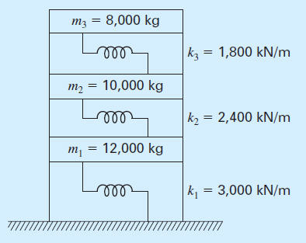
Dynamics of Three Story Building

Slide 20
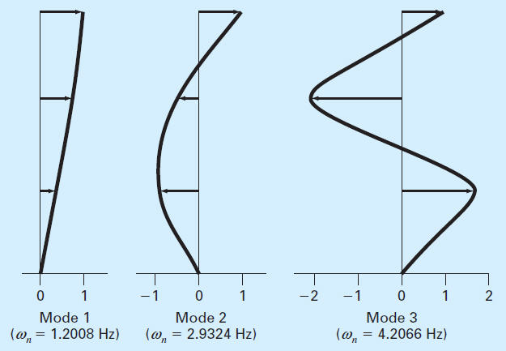
Principle Modes of Vibration

